Slide 1
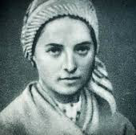
St Bernadette

Slide 2
Facts
She was born in Lourdes, France.
On 7th January 1844.
Her family were very poor and she had 8 siblings.
As she grew up was poorly.
Bernadette got her first vision age 14. It was a young lady in a grotto.
The lady told her to return to the grotto. She kept returning. She described the lady that seemed like the Virgin Mary. Only some people believed her.

Slide 3
Facts
Eventually the Catholic Church believed her.
She went to live in a convent and became a nun.
She helped the sick.
She died April 16th 1879.
She was buried at St Gildard convent.

