Slide 1
Dignity
What does it mean ?

Slide 2
What does it mean ?
Dignity means someone who is in a very high position and deserves respect from others and is very self confident and proud of who they are as a person.

Slide 3
Why does god want us to use Dignity ?
God wants you to use dignity in your daily life because he believes that everyone who is a good person and who is a kind person deserves respect and deserves to be honoured .

Slide 4
Who deserves dignity ?
People who deserve dignity are Saints, Priests, friends and overall… EVERYONE !
Everyone deserves dignity because God used to treat everyone equally and with dignity so that is what he wants us to do .

Slide 5
How can we use Dignity in a daily lives ?
In are daily lives we can use Dignity by showing others who you are and making sure you are confident and comfortable Infront of everyone. If you do this, you are using Dignity everyday !

Slide 6
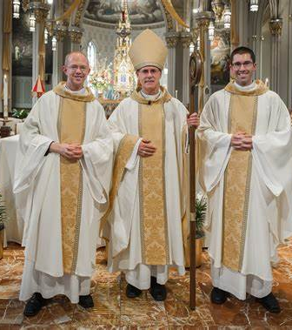
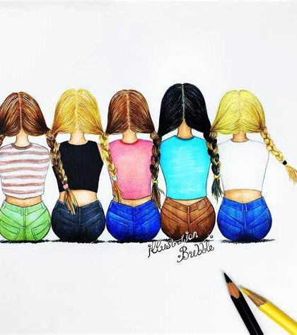
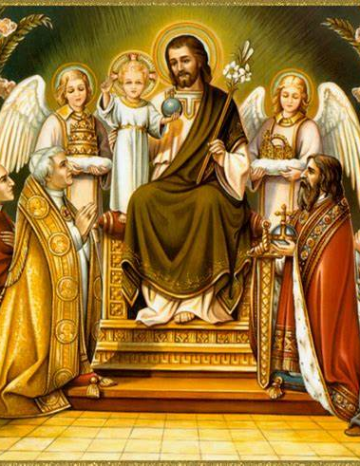
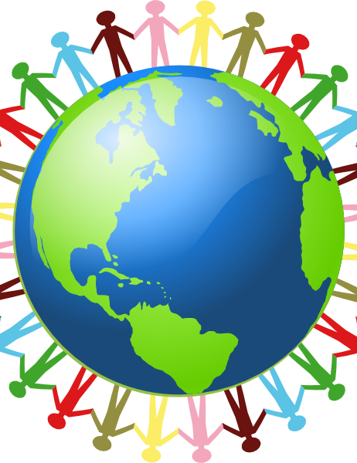
I hope you enjoyed
Thank you for listening and I hope you will show dignity everyday !
Here is a reminder of what specific people deserve dignity .

